Slide 1



Day90-95: React/Laravel – Passport Authentication

Slide 2
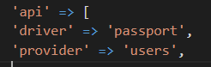
Installing passport
composer create-project laravel/laravel:^9.0 passrest
php artisan serve
Create a database passport in phpMyAdmin
Then modify .env to link the passport db
php artisan migrate
composer require laravel/passport
php artisan migrate
php artisan passport:install
Copy the keys to .env file
Use HasApiTokens in User model, use Laravel\Passport\HasApiTokens;
Modify config/auth to include the ff:
Create an AuthController

Slide 3
Login Authentication
Create Login route in api route
Create Login() in AuthController
Use Exception, Auth, User, DB and Hash in AuthController in Login()
Complete the instructions for Login()
Test the login api route, for invalid err message.

Slide 4
Register Authentication
Create Register route in api route
Create Register() in AuthController
Create a customized request: php artisan make:request RegisterRequest
Add this in AuthController: use App\Http\Requests\RegisterRequest;
Modify RegisterRequest, authorize, rules
Modify Register()
Test the register route, then login route

Slide 5
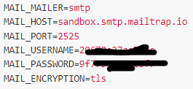
Forgot Password
Create an account in mailtrap.io
Click start Testing, select inbox, select Laravel 7+ integration
Modify the env mail settings by swapping the values from mailtrap
Create forgetpassword route
Create ForgetController then copy from AuthController the ff:
use Illuminate\Support\Facades\Auth;
use Exception;
use App\Http\Requests\RegisterRequest;
use App\Models\User;
use Illuminate\Support\Facades\DB;
use Illuminate\Support\Facades\Hash;
Create custom request: php artisan make:request ForgetRequest
Add ForgetRequest to ForgotPassword Controller

Slide 6
Forgot Password (cont)
Modify ForgetController, create the ForgetPassword()
Add validation in ForgetRequest, authorize, rules
Modify ForgetController
Create ForgetMail, php artisan make:mail ForgetMail
Use mail and forgetMail in ForgetController
Modify ForgetMail: public $token, __construct, content()
Create folder mail in resources/views
Create a forget.blade.php
Then Test in Postman the forgetpassword route, use body form-data
Check mailtrap if the mail was sent successfully

Slide 7
Reset Password
Create a resetpassword api route, then create a ResetController.
Create resetpassword() in resetcontroller.
Copy from AuthController the ff:
use Illuminate\Support\Facades\Auth;
use Exception;
use App\Http\Requests\RegisterRequest;
use App\Models\User;
use Illuminate\Support\Facades\DB;
use Illuminate\Support\Facades\Hash;
Create custom request: php artisan make:request ResetRequest
Add ResetRequest to ResetPassword Controller
Add validation in ResetRequest, authorize, rules
Modify the ResetController, add necessary codes.
Then Test in Postman the resetpassword route, use body form-data
Check the password_resets if deleted, also try to use login route to verify that password has been reset

Slide 8
Current User
Create a user api route, then create a UserController.
Create user() in UserController.
Then Test in Postman the user route, log a user first then copy the token generated and in user route paste in authorization bearer token.

Slide 9
Frontend - React Passport Authentication

Slide 10
Create react app
npx create-react-app reactauth
npm i react-router-dom
npm install axios
Integregrate bootstrap5 cdn in index.html
In src create folders: common, components
In common folder: Header.jsx, Nav.jsx then create react scaffolds for both
Modify header page, then include in index.js
Modify nav component, include nav snippets from bootstrap 5.2, put necessary modifications, then include in header component.
In header include import { BrowserRouter as Router, Switch, Route, Link, } from "react-router-dom"; from reactrouter site.
Create Home in components, use rce scaffolds, then integrate to route in Header page.

Slide 11
Login Module Design and configuring Nav with React router
In Nav include import { BrowserRouter as Router, Switch, Route, Link, } from "react-router-dom";
Create additional pages in components: Profile, Login, Register, Forget. This components must be have routes in header.
In Nav component, change the a to Link, and href to to with URL.
Make appropriate design for Login page using bootstrap 5
Also get form snippets.
Add a forget link in the Login page, create appropriate forget route in Header.

Slide 12
Register, Forget, Profile module Design
Create the register module design, copy the necessary login codes to modify
Create the forget module design, copy the necessary login codes to modify
Create the profile module design, copy the necessary login codes to modify, get a list control snippets from bootstrap

Slide 13
React Login Module and Laravel API
Modify the login, assign name, and integrate on change event, also use this.setState to update state of variables.
Check using React Dev Tools in browser.
Add onSubmit in form, then create this.formSubmit()
Copy the axios post template from https://github.com/axios/axios
import axios from 'axios’;
Create const data to hold the values to be passed into axios.post(params)
Then pass the data axios.post(‘/login’,data)
Create base url in index.js, axios.defaults.baseURL='http://localhost:8000/api’;
Load the login page, then check the network in the dev tools, click login, payload/preview

Slide 14
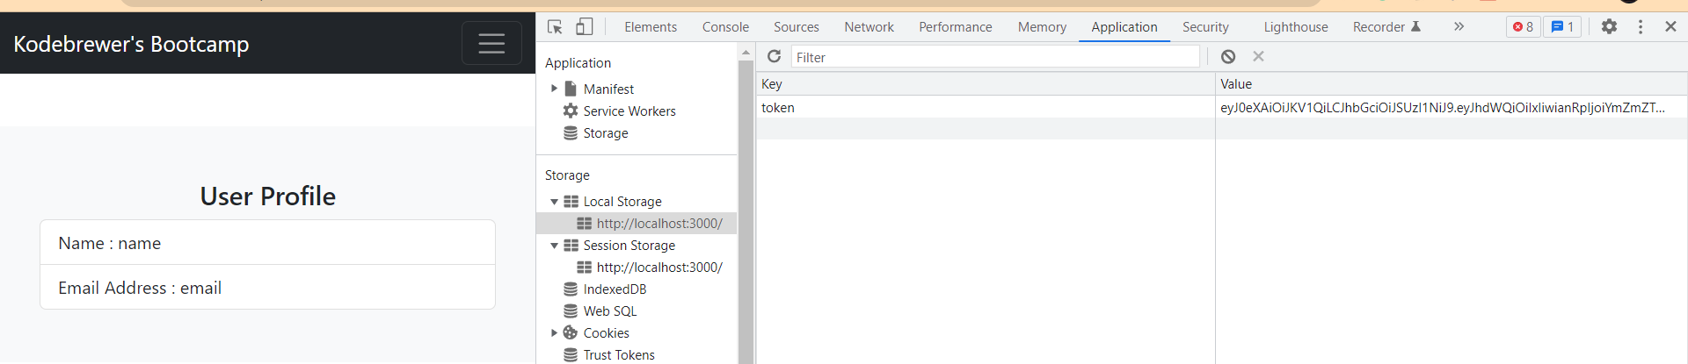
Storing response into localstorage, and redirect to profile.
To access localstorage, open dev tools, then select application, then localstorage.
Modify login module, then refactor the axios response to store the token to localstorage using state.
Also create loggedin state as basis for redirect to profile
Create a redirect to profile inside render() before return.
Check the login in browser, it should store the token in the application and do redirect to profile.

Slide 15
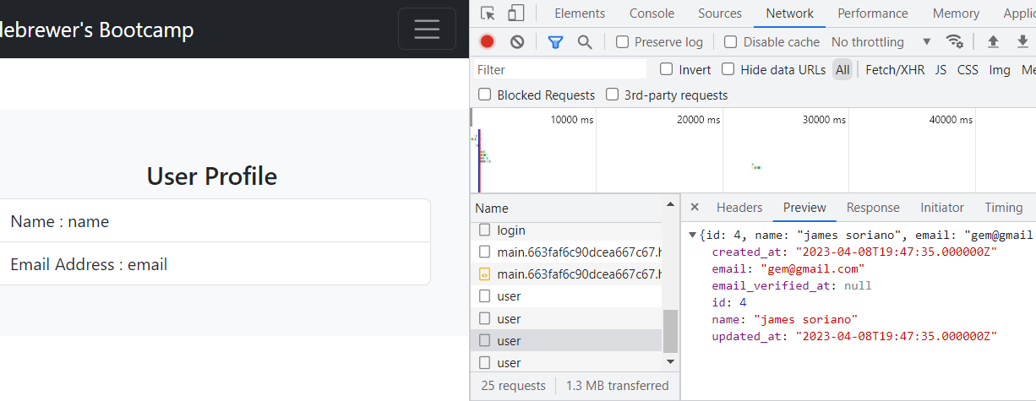
Retrieving Data only When loggedin
Modify header page, create state for user then create componentdidmount then use axios to get the data. Also setUser state.
Include the token in the axios
Just copy the axios from login then do a necessary modification, like removing pass in parameter for data. The response is enough for getting the details.
Do the codes within the class header before the render()
In index.js include the authorization’s bearer token using axios.
Make data visible to nav by setting the state in header inside nav component thru props.
Now check the login in the browser, it should now redirect to profile with user data like image below

Slide 16
Displaying the retrieved user data to Profile Page
In header, passed in the user data thru props in Profile route.
Then extract the user data props in Profile page.
Then embed the variables containing the values.
Then test the Page by going first to login api then it will redirect to profile page if logged in.
Also create a protected component to include the profile page, then modify again the header page.

Slide 17
Creating the Register Page
Copy the logical codes of login page.
Do necessary modification on Register page to reflect what should be sent to request.
Create new account, then automatically the page will be redirected to Profile page.

Slide 18
Modifying the Nav Component based on Login token(Logout)
Modify Nav component by adding logout, buttons, profile to dynamically clear token and replace the navigation button, including hiding profile page.
Do necessary modification on Register page to reflect what should be sent to request.
Test the app.

Slide 19
Creating Forgot and Reset Password
Create reset route.
Create reset component.
Modify Forget component like login page.
Do necessary modification on Forget page to reflect what should be sent to request.
Test the app, Check mailtrap and password_resets table.

Slide 20
Displaying messages
Modify the Forget component
Add necessary codes to reflect form reset, and displaying of messages using b5 alert snippet
Test the app if the messages are shown on form.
You may also do this in Login page and others.

Slide 21
Completing Reset Password
Check mailtrap inbox link if the link is working to forward to reset page in localhost.
Modify the reset by copying the register page, alter name to token.
Copy the response and message error handling in forget page.
Do necessary modification on Reset page to reflect what should be sent to request.
Test the app, Check mailtrap, password_resets table, login.

Slide 22
Protecting the login while logged
Modify login and add the following
// redirect to if logged
if (localStorage.getItem('token')) {
return <Navigate replace to={'/profile'} />
}

Slide 23
Thank you!

